Slide 1
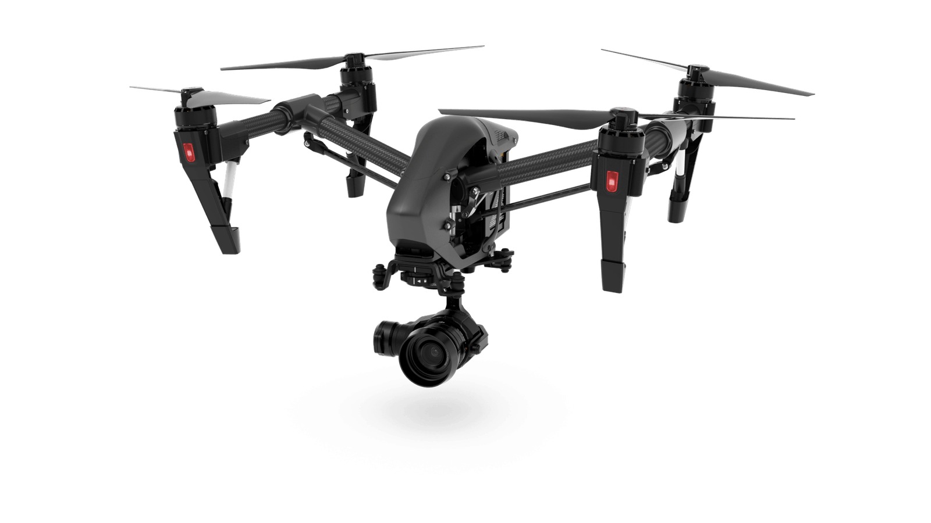
PROJECT GARUDA
UAV with Advanced Human Tracking and Enumeration Technology
Presented By,
HEMA HARIHARAN S
JEEVANDHAM S
KABILAN V
WASEEMULLAH K
513520104009
513520104012
513520104014
513520104043
GUIDED BY
Mrs. J. SAVITHIRI M.E, (AP/CSE)

Slide 2
ABSTRACT
Search and rescue missions during disasters demand swift and efficient locating of injured and lost individuals, crucial for saving lives and minimizing costs.
Unmanned aerial vehicles (UAVs), commonly referred to as drones, are increasingly utilized for remote surveillance and reconnaissance in disaster scenarios due to their adaptability and accessibility.
AI-assisted UAVs equipped with CNN-based algorithms can process captured images instantaneously, enabling the identification of wounded and trapped individuals during flight.
The project uses UAV footage and a Python program to track humans in disaster scenes. This helps rescue teams prepare by providing real-time information on the number of people present.

Slide 3
INTRODUCTION
Disaster situations require swift and effective strategies to locate and assist affected individuals.
Delays in disaster response can lead to significant consequences, including loss of life and increased damage.
Technological advancements, such as UAVs and AI, offer promising solutions to enhance traditional rescue methods.
Identifying and locating individuals in disaster scenarios is crucial for prioritizing rescue efforts and resource allocation.
This project aims to leverage UAVs and AI algorithms to improve human detection in disaster zones, providing real-time information to enhance rescue team preparedness and response capabilities.

Slide 4
EXISTING SYSTEM
Current systems for disaster response often rely on manual search methods, which can be time-consuming and resource-intensive.
Some existing technologies, such as satellite imagery and ground-based sensors, provide valuable data for disaster assessment and response but may have limitations in real-time human detection.
Traditional manned aerial surveillance methods, while effective, may be hindered by factors like weather conditions and accessibility to the affected areas.
Humanitarian organizations and emergency response teams often face challenges in coordinating information and resources across multiple agencies and stakeholders during disaster situations.

Slide 5
DRAWBACKS
Limited Speed and Efficiency
Dependence on Human Resources
Restricted Access to Remote Areas
Lack of Real-Time Monitoring
Difficulty in Coordination

Slide 6
PROPOSED SYSTEM
The proposed system utilizes UAVs equipped with AI-based algorithms to provide real-time detection and tracking of humans in disaster zones, enabling swift response and rescue operations.
By automating the detection process through AI, the system significantly reduces the time and resources required for human identification, improving overall response efficiency and accuracy.
UAVs offer the advantage of remote operation and access to hard-to-reach or hazardous areas, allowing for comprehensive surveillance and assessment of disaster situations.

Slide 7
ADVANTAGES
Rapid Response
Resource Optimization
Enhanced Safety
Versatility
Continuous Monitoring
Improved Coordination

Slide 8
LITERATURE SURVEY
TOWARD AI-ASSISTED UAV FOR HUMAN DETECTION IN SEARCH AND RESCUE MISSIONS
Authors: Mostafa Rizk, Fatima Slim, Jamal Charara
Year: 2023
The paper discusses a system designed to improve search and rescue missions during disasters by integrating unmanned aerial vehicles (UAVs) with artificial intelligence (AI) algorithms. Specifically, it focuses on using convolutional neural networks (CNN) for real-time detection of injured or lost individuals. By combining AI with UAV capabilities, the system aims to swiftly locate and transmit information about victims to ground stations, enhancing rescue coordination.

Slide 9
LITERATURE SURVEY (CONTI…)
ADVANCED NOISE SUPPRESSION TECHNOLOGY FOR IMPROVED SEARCH
AND RESCUE DRONES
Source: Shibaura Institute of Technology
Year: 2024
Unmanned Aerial Vehicles (UAVs) are beneficial in search and rescue missions during natural disasters like earthquakes. However, current UAVs depend on visual information and cannot detect victims trapped under rubble. While some studies have used sound for detection, the noise from UAV propellers can drown out human sounds. To address this issue, researchers have developed a novel artificial intelligence based system that effectively suppresses UAV noise and amplifies human sounds.

Slide 10
LITERATURE SURVEY (CONTI…)
DRONE-TOOD: A LIGHTWEIGHT TASK-ALIGNED OBJECT DETECTION ALGORITHM FOR VEHICLE DETECTION IN UAV IMAGES
Author: Kaitong Ou, Chaojun Dong, Xiankun Liu, Yikui Zhai, Ye Li, Wanxia Huang, Wenkang Qiu, Yizhi Wang, And Chengxuan Wang
Year: 2024
The research presents Drone-TOOD, a specialized vehicle object detection model for UAV images crucial for urban traffic management and autonomous driving. It tackles challenges such as target size variations and image degradation from UAV movement. Validation on the UAVDT dataset confirms its robustness, making it suitable for real-world deployment.

Slide 11
LITERATURE SURVEY (CONTI…)
UNMANNED AERIAL VEHICLES (UAVs) FOR DISASTER MANAGEMENT
Author: Osama Bushnaq, Enrico Natalizio
Year: 2022
This paper delves into the burgeoning interest in Unmanned Aerial Vehicles (UAVs) for various commercial and military applications, including aerial surveillance, border protection, transportation, and disaster management. It outlines the key features that make UAVs particularly advantageous for disaster management teams while also acknowledging their limitations in handling disaster scenarios. Furthermore, the paper briefly explores the range of services that UAVs can provide to enhance disaster management efforts.

Slide 12
LITERATURE SURVEY (CONTI…)
A REAL-TIME TRACKING ALGORITHM FOR MULTI-TARGET UAV BASED ON DEEP LEARNING
Author: Tao Hong, Hongming Liang, Qiye Yang, Linquan Fang, Michel Kadoch and Mohamed Cheriet
Year: 2023
This study addresses the growing integration of Unmanned Aerial Vehicles (UAVs) into daily life. It proposes a real-time UAV tracking scheme utilizing the 5G network and machine learning algorithms to detect and track multiple targets. Through optimization of the YOLO4 network structure and improvement of the DeepSORT target tracker, the study achieves high tracking accuracy and detection speed. Deployment on the ZCU104 validates the feasibility of the proposed scheme.

Slide 13
LITERATURE SURVEY (CONTI…)
UNMANNED AERIAL VEHICLES (UAVS): A SURVEY ON CIVIL APPLICATIONS AND KEY RESEARCH CHALLENGES
Author: Hazim Shakhatreh, Ahmad Sawalmeh, Ala Al-Fuqaha, Zuochao Dou4, Eyad Almaita, Issa Khalil, Noor Shamsiah Othman, Abdallah Khreishah, Mohsen Guizani
Year: 2017
The use of unmanned aerial vehicles (UAVs) is rapidly expanding across diverse civil applications, including real-time monitoring and precision agriculture, with smart UAVs poised to revolutionize civil infrastructure. This survey highlights UAV civil applications, challenges, and current research trends, providing insights into future potential uses. Key challenges include collision avoidance, swarming, and networking issues, with discussions on addressing these challenges based on recent literature.

Slide 14
SOFTWARE REQUIREMENTS
SOFTWARE USED LANGUAGE
MODULES
ALGORITHMS
: VS Code editor
: Python
: OpenCV, Pandas, Numpy, Ultralytics.YOLO, Tracker (User Defined)
: YOLO Object Detection Algorithm

Slide 15
HARDWARE REQUIREMENTS
SYSTEM
HARDDISK
MONITOR
INPUT DEVICES
RAM
CONNECTIVITY
: Intel or AMD processor (Latest Gen)
: 50 GB (Minimum)
: 15” LED / Any Display
: Keyboard, Mouse, Camera, Microphone, Drone & Controllers
: 8GB (Minimum)
: LAN or WIFI

Slide 16
MODULES DESCRIPTION
Description of important modules used in the program
OpenCV
Pandas
Numpy
Ultralytics.YOLO
Tracker

Slide 17
MODULES DESCRIPTION ( CONTI..)
OpenCV (cv2): Used for capturing video frames from a camera (VideoCapture). Utilized for resizing frames (resize) and displaying images (imshow and waitKey).
Pandas (pd): Employed for creating and manipulating data frames (DataFrame). Used to convert bounding box data into a pandas DataFrame for easier handling (pd.DataFrame).
NumPy (np): Utilized for numerical computations and array manipulation (astype). Likely used for processing bounding box data and performing calculations on arrays (numpy.array).
Ultralytics YOLO: The YOLO object detection model from the Ultralytics library is imported and utilized for object detection tasks (YOLO). Used to predict objects in each frame (model.predict).

Slide 18
MODULES DESCRIPTION ( CONTI..)
Tracker (User Defined):
The Tracker class is responsible for tracking objects across frames in a video stream
In the main.py script, the Tracker class is instantiated at the beginning. This initializes the object tracker, setting up attributes to store object positions and IDs.
The script captures video frames from the camera using OpenCV's.
The script then processes every third frame (if count % 3 != 0:), reducing computational load.
The YOLO model (model) is used to detect objects in the current frame.
The bounding box coordinates of detected objects are extracted and converted into a pandas DataFrame.
The update method of the Tracker class is called, passing the bounding box coordinates of detected objects.

Slide 19
MODULES DESCRIPTION ( CONTI..)
The Tracker class updates its internal state, tracks object movements, and returns a list of tracked objects with their bounding box coordinates and assigned.
For each tracked object in the list, the script draws a rectangle around the object's bounding box and displays its ID on the video frame.
The script increments a counter (person_count) for each detected person and displays the count on the video frame using cv2.putText().
The processed video frame, including tracked objects and the person count, is displayed in a window using cv2.imshow().
The main loop continues until the user presses the 'Esc' key, upon which the video capture is released, and OpenCV windows are destroyed.

Slide 20
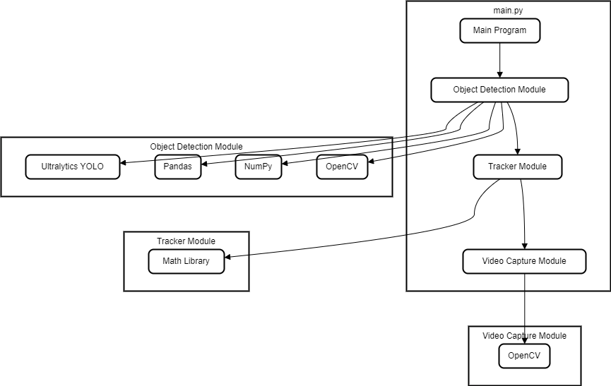
SYSTEM DESIGN
A system architecture is a conceptual model that outlines a system's structure, behaviour, and additional viewpoints. An architectural description is a formal description and representation of a system that is arranged in a way that allows for reasoning about the system's structures and actions.
SYSTEM ARCHITECTURE

Slide 21
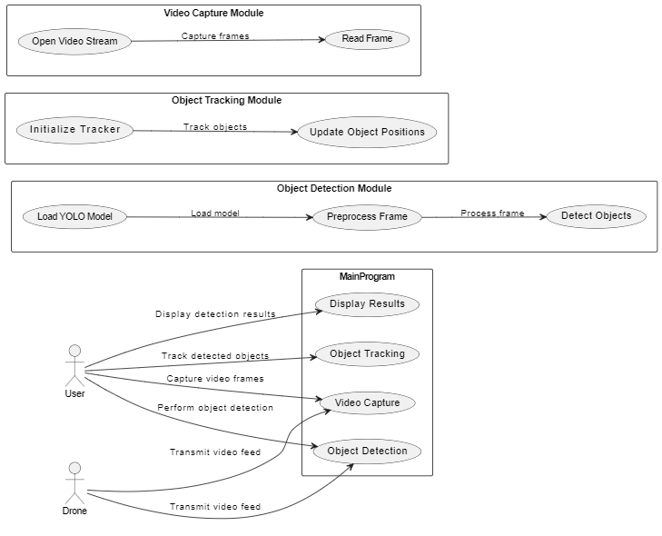
SYSTEM DESIGN (CONTI..)
USECASE DIAGRAM
A use case diagram can summarize the details of your system's users (also known as actors) and their interactions with the system. To build one, you'll use a set of specialized symbols and connectors. A use case diagram is a graphical depiction of a user's possible interactions with a system.

Slide 22
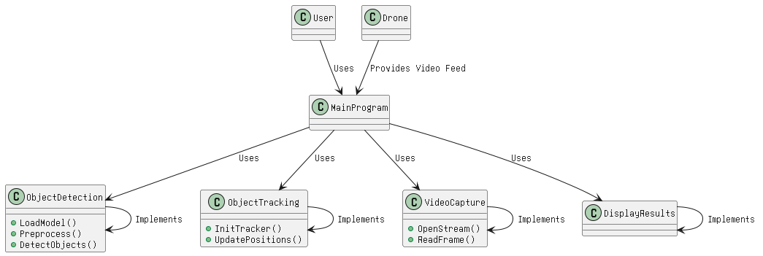
SYSTEM DESIGN (CONTI..)
CLASS DIAGRAM
A class diagram is a static diagram that represents the attributes, operations, and constraints of a class in an application. It is used to visualize, describe, and document various aspects of the system. Class diagrams have a direct mapping with object-oriented languages and are widely used during the construction phase of software development. Their main purpose is to model the static structure of an application.

Slide 23
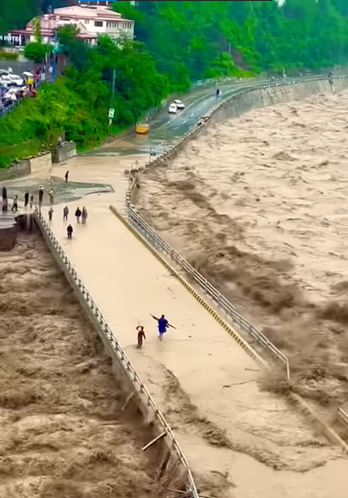
SCREENSHOTS
Nepal Flood 2022 Footage
Hard to count the people…

Slide 24
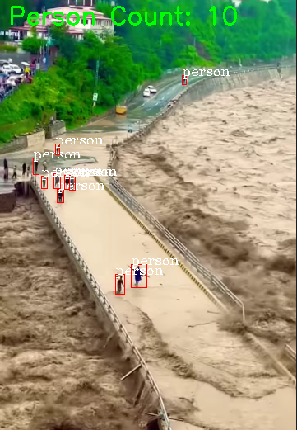
SCREENSHOTS
Easy to count the people…(Approx)

Slide 25
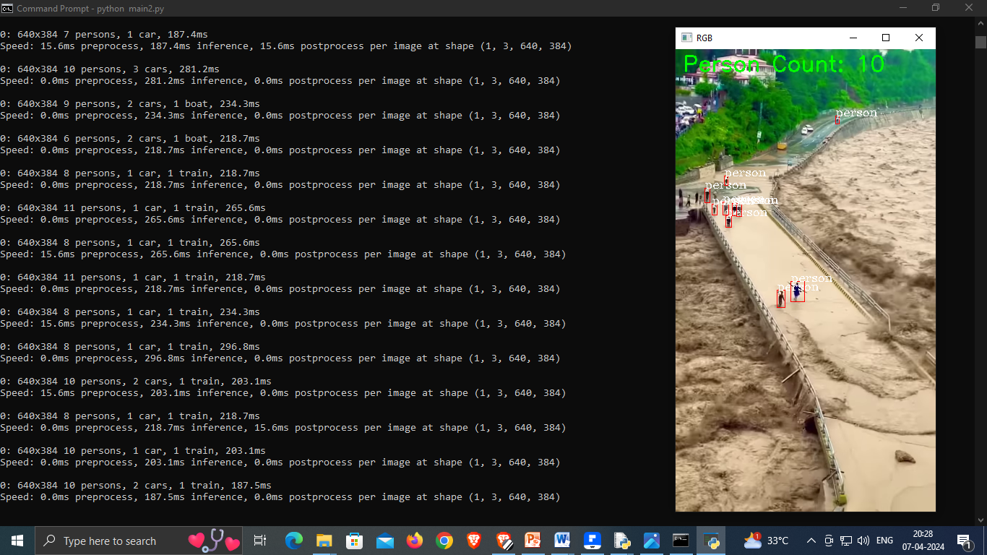
SCREENSHOTS

Slide 26
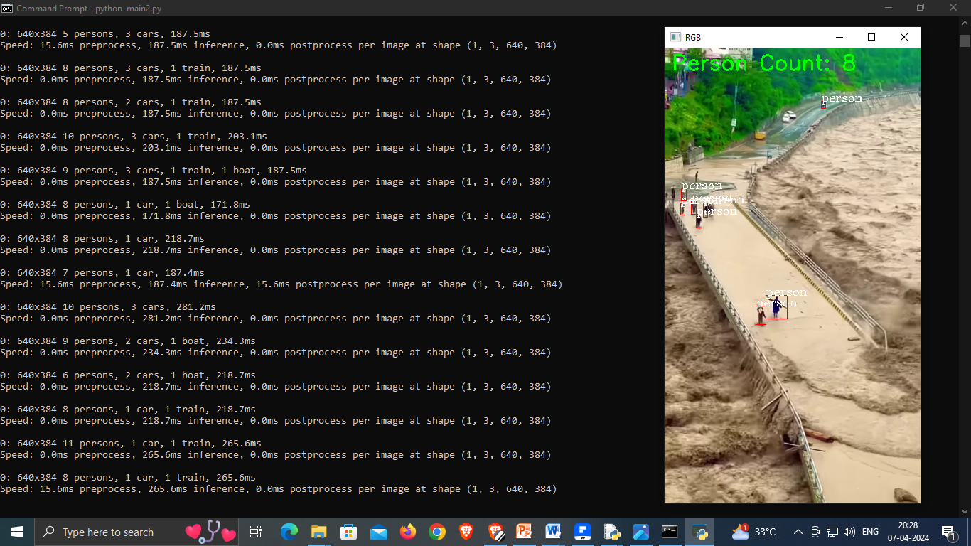
SCREENSHOTS

Slide 27
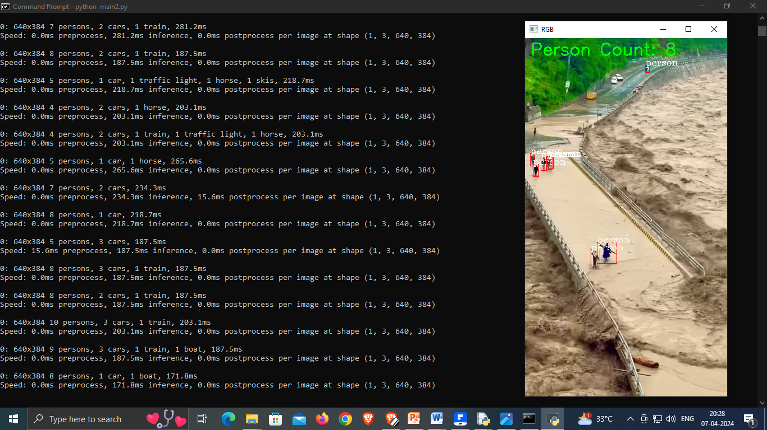
SCREENSHOTS

Slide 28
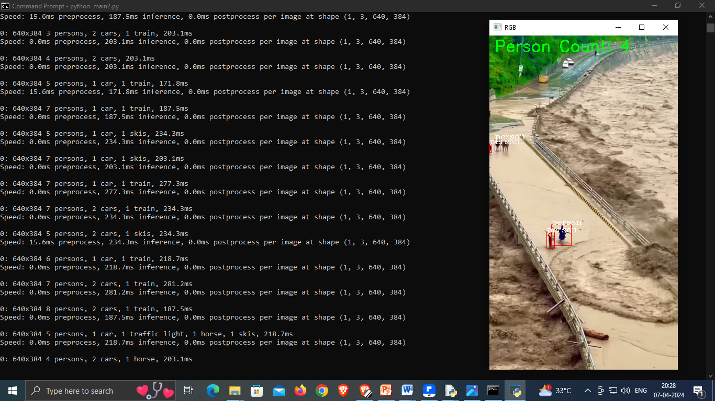
SCREENSHOTS

Slide 29
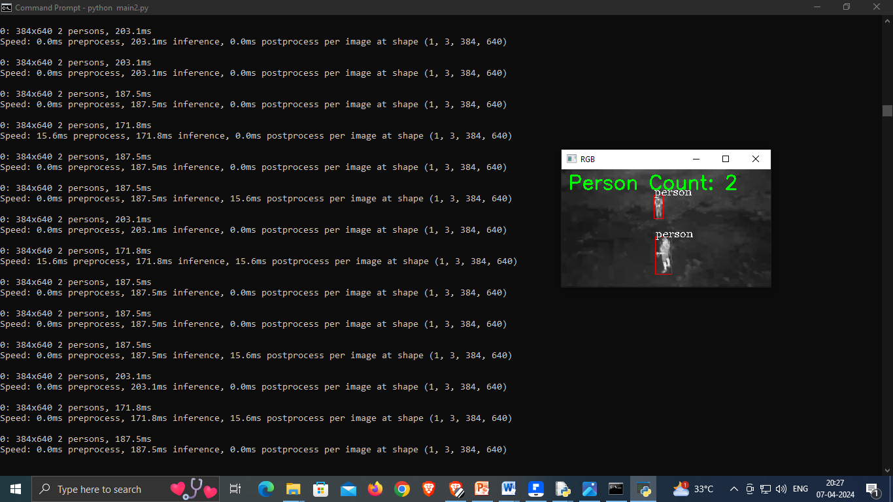
SCREENSHOTS
Thermal Vision

Slide 30

SCREENSHOTS
Thermal Vision

Slide 31
CONCLUSION
The integration of advanced technologies such as object detection algorithms and UAVs showcases promising potential for enhancing disaster management and search-and-rescue operations.
The system's ability to rapidly detect and track objects in disaster scenarios can significantly improve response times and resource allocation, ultimately saving lives and minimizing damage.
Despite the progress made, ongoing research and development are necessary to address challenges such as algorithm accuracy, real-time processing efficiency, and deployment scalability.
Continued collaboration between academia, industry, and governmental agencies is crucial to further refine and deploy such systems, ensuring their effectiveness in real-world disaster scenarios.

Slide 32
FUTURE ENHANCEMENT
Continuously improving object detection algorithms, such as leveraging deep learning techniques and training on diverse datasets, can enhance the system's ability to accurately identify objects in various environmental conditions.
Incorporating additional sensor data, such as infrared or thermal imaging, alongside visual data from UAVs can provide a more comprehensive understanding of disaster scenarios, enabling more informed decision-making by rescue teams.
Developing real-time decision support systems that analyze detected objects and provide actionable insights to rescue teams, such as suggesting optimal routes or prioritizing rescue efforts based on the severity of detected injuries.
Implementing autonomous UAV swarms equipped with coordinated object detection and tracking capabilities can significantly expand coverage areas and improve response times in large-scale disaster scenarios, enhancing overall search-and-rescue operations.

Slide 33
REFERENCES
Toward AI-assisted UAV for Human Detection In Search and Rescue Missions, Mostafa Rizk, Fatima Slim, Jamal Charara, 2023
Advanced Noise Suppression Technology for Improved Search and Rescue Drones, Shibaura Institute of Technology, 2024
Drone-tood: A Lightweight Task-aligned Object Detection Algorithm for Vehicle Detection In UAV Images, Kaitong Ou, Chaojun Dong, Xiankun Liu, Yikui Zhai, Ye Li, Wanxia Huang, Wenkang Qiu, Yizhi Wang, And Chengxuan Wang, 2024
Unmanned Aerial Vehicles (UAVs) for Disaster Management, Osama Bushnaq, Enrico Natalizio, 2022
A Real-time Tracking Algorithm for Multi-target UAV Based on Deep Learning, Tao Hong, Hongming Liang, Qiye Yang, Linquan Fang, Michel Kadoch and Mohamed Cheriet, 2023
Unmanned Aerial Vehicles (UAVs): A Survey On Civil Applications And Key Research Challenges, Hazim Shakhatreh, Ahmad Sawalmeh, Ala Al-Fuqaha, Zuochao Dou4, Eyad Almaita, Issa Khalil, Noor Shamsiah Othman, Abdallah Khreishah, Mohsen Guizani, 2017

Slide 34

ANY QUESTIONS?

Slide 35
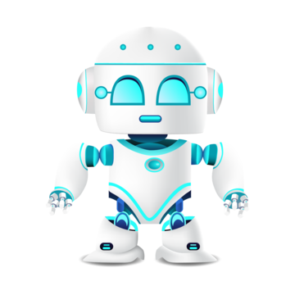
THANK YOU

